Slide 1


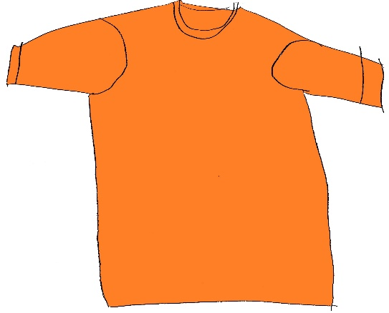

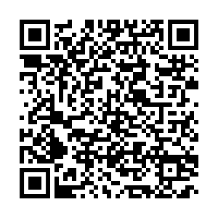
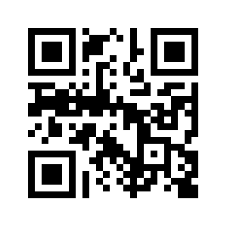
Ways to commemorate Orange Shirt Day and the National Day for Truth & Reconciliation
Start or continue your journey toward reconciliation by engaging with U of T Engineering’s Indigenous Cultural Competency Toolkit, with a focus on exploring the section titled “As a non-Indigenous person, how can I help?”
Learn about the significance of Orange Shirt Day and wear an orange shirt on September 30.
EVERY
CHILD
MATTERS.
Adapted from art by
Timmy Bazylak 6 YO Metis.

Slide 2
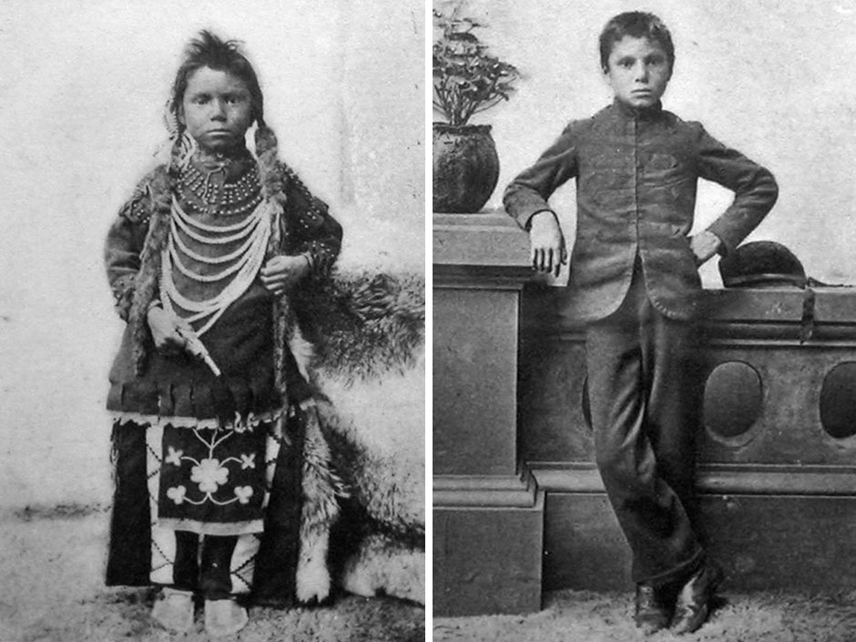
Weaponization of Education: Residential Schools
When the school is on the reserve the child lives with its parents, who are savages; he is surrounded by savages, and though he may learn to read and write his habits, and training and mode of thought are Indian. He is simply a savage who can read and write. It has been strongly pressed on myself, as the head of the Department, that Indian children should be withdrawn as much as possible from the parental influence, and the only way to do that would be to put them in central training industrial schools where they will acquire the habits and modes of thought of white men.
– John A. Macdonald to the House of Commons
1st Prime Minister of Canada
https://thecanadianencyclopedia.ca/en/collection/educational-resources-indigenous-peoples-in-canada
Notes:
Note the bolding. John A. Macdonald, one of the most powerful people in Canada at the time, did not believe Indigenous people were people. He refers to them by “it” and “savages.” He very clearly indicates that the purpose of residential schools was to kill the Indigenous ways of living and knowing.
It is not surprising that to this day Indigenous People have a complicated relationship with educational institutions, especially those, like UofT, that present in a very colonial way.

Slide 3

Notes:
posted

Slide 4

Notes:
posted

Slide 5


Slide 6


Slide 7

Notes:
This slide to run each week in both decks up to including week of Oct. 19.

Slide 8


Slide 9

Notes:
posted

Slide 10


Slide 11


Slide 12


Slide 13


Slide 14


Slide 15



ENGINEERING MATH LEARNING CENTRE
A designated space for math studying and office hours for first-year engineering students, staffed by instructors and teaching assistants!
Mondays 5–7 p.m. in MY 317
Tuesdays 5–7 p.m. in MY 440
Wednesdays 5–7 p.m. in MY 317

Slide 16

ENGINEERING MATH LEARNING CENTRE
A designated space for math studying and office hours for first-year engineering students, staffed by instructors and teaching assistants!
Mondays 5–7 p.m. in MY 317
Tuesdays 5–7 p.m. in MY 440
Wednesdays 5–7 p.m. in MY 317

Slide 17


